Slide 1
Testing Legacy Code effectively with Approval Tests Workshop for C++ on Sea, 2020
t3a.2xlarge
@ClareMacraeUK @LlewellynFalco

Slide 2
Links
Testing Legacy Code effectively with Approval Tests Workshop for C++ on Sea, 2020
t3a.2xlarge
@ClareMacraeUK @LlewellynFalco

Slide 3
Testing Functional Code
Exercise:
- Retrospective

Slide 4
Tell me and I forget,
teach me and I may remember,
involve me and I learn.
- Xun Kuang (312-230 BC)

Slide 5
Awareness (show) Proficiency (do) Fluency (repeat)

Slide 6
0 -> 1

Slide 7
Steps 1. Test (fail, get information) 2. Test (pass, locking results) 3. Check coverage (guidance)

Slide 8
HOW HARD WAS THIS?
✋
✌️
✊
Very
Not at all

Slide 9
HOW DID THIS FEEL?
💬

Slide 10
RELEVANCE TO YOUR WORK?
✋
✌️
✊
Completely
Not at all

Slide 11
EASY TO TEST… WHY?
💬

Slide 12
Simple code
Let’s start with the first set of slides

Slide 13
Small methods?
double TrigMath::cot(double angle) { auto idx = floor(angle * SIN_CONVERSION_FACTOR); idx += 1; idx = 3.1 * idx; auto dx = 2.1; for ( int i = 0; i <= 10; ++i ) { idx = (idx * dx * 9.7) / 42.0; } idx = integrate(idx, 2, 13); idx += pow(idx, 2); idx = tan(idx); idx = idx * DEG_TO_RAD; idx = integrate(idx, 2, 13); idx += pow(idx, 2); idx = tan(idx); idx = idx * DEG_TO_RAD; idx = integrate(idx, 2, 13); idx += pow(idx, 2); idx = tan(idx); idx = idx * DEG_TO_RAD; return cosRaw(idx) / sinRaw(idx); }
double TrigMath::tan(double angle) { auto idx = floor(angle * SIN_CONVERSION_FACTOR); return sinRaw(idx) / cosRaw(idx); }
double TrigMath::sec(double angle) { return angle / rand(); }

Slide 14
Functional Code
1. All inputs
2. deterministic
3. All results

Slide 15
Non-Functional Code
(No Inputs)
get inputs from global state;
use random, dates, or other varying data;
write results to global state;
(No Return)

Slide 16
All inputs in
public double calculate(double amount)
{
int step1 = (int) (amount * 2);
double step2 = step1 * 1.5;
return step2;
}
Deterministic
All results out

Slide 17
All inputs in?
public int Advance()
{
return steps++;
}

Slide 18
All inputs in?
public int age(DateTime birthDate)
{
var timeSpan = DateTime.Now - birthDate;
var age = DateTime.MinValue + timeSpan;
return age.Year-1;
}
Deterministic?

Slide 19
All results out?
public void saveFile(Person info, string fileName)
{
File.WriteAllText(fileName, info.ToString());
}

Slide 20
Why functional is easier for tests
Unit Test
Production Code
Do
Verify

Slide 21
Why functional is easier for tests
Unit Test
Functional Harness
Production Code
Do
Verify

Slide 22
Benefits of Unit Tests
Specification
Feedback
Regression
Granularity

Slide 23
Benefits of Unit Tests
Specification
Feedback
Regression
Granularity

Slide 24
Regression
A
A
If I used to get :
Then I still get :
Notes:
Both

Slide 25
Locking test

Slide 26
Poke
👉

Slide 27
Next Steps
making your code easy to test

Slide 28
Next Steps
making your code easy to test

Slide 29
Next Steps
better ways of testing functional
making your code easy to test

Slide 30
INSTRUCTIONS FOR USE
EDIT IN GOOGLE SLIDES
Click on the button under the presentation preview that says "Use as Google Slides Theme".
You will get a copy of this document on your Google Drive and will be able to edit, add or delete slides.
You have to be signed in to your Google account.
EDIT IN POWERPOINT®
Click on the button under the presentation preview that says "Download as PowerPoint template". You will get a .pptx file that you can edit in PowerPoint.
Remember to download and install the fonts used in this presentation (you’ll find the links to the font files needed in the Presentation design slide)
More info on how to use this template at www.slidescarnival.com/help-use-presentation-template
This template is free to use under Creative Commons Attribution license. You can keep the Credits slide or mention SlidesCarnival and other resources used in a slide footer.

Slide 31

HELLO!
I am Jayden Smith
I am here because I love to give presentations.
You can find me at @username

Slide 32
1.
TRANSITION HEADLINE
Let’s start with the first set of slides

Slide 33
Quotations are commonly printed as a means of inspiration and to invoke philosophical thoughts from the reader.

Slide 34
THIS IS A SLIDE TITLE
Here you have a list of items
And some text
But remember not to overload your slides with content
Your audience will listen to you or read the content, but won’t do both.

Slide 35
BIG CONCEPT
Bring the attention of your audience over a key concept using icons or illustrations

Slide 36
YOU CAN ALSO SPLIT YOUR CONTENT
White
Is the color of milk and fresh snow, the color produced by the combination of all the colors of the visible spectrum.
Black
Is the color of ebony and of outer space. It has been the symbolic color of elegance, solemnity and authority.

Slide 37
IN TWO OR THREE COLUMNS
Yellow
Is the color of gold, butter and ripe lemons. In the spectrum of visible light, yellow is found between green and orange.
Blue
Is the colour of the clear sky and the deep sea. It is located between violet and green on the optical spectrum.
Red
Is the color of blood, and because of this it has historically been associated with sacrifice, danger and courage.

Slide 38

A PICTURE IS WORTH A THOUSAND WORDS
A complex idea can be conveyed with just a single still image, namely making it possible to absorb large amounts of data quickly.

Slide 39

Want big impact?
Use big image.

Slide 40
USE CHARTS TO EXPLAIN YOUR IDEAS
White
Gray
Black

Slide 41
AND TABLES TO COMPARE DATA
 | A | B | C
Yellow | 10 | 20 | 7
Blue | 30 | 15 | 10
Orange | 5 | 24 | 16

Slide 42
MAPS
our office

Slide 43
89,526,124
Whoa! That’s a big number, aren’t you proud?

Slide 44
89,526,124$
185,244 users
100%
That’s a lot of money
And a lot of users
Total success!

Slide 45
OUR PROCESS IS EASY
first
second
last

Slide 46
LET’S REVIEW SOME CONCEPTS
Yellow
Is the color of gold, butter and ripe lemons. In the spectrum of visible light, yellow is found between green and orange.
Blue
Is the colour of the clear sky and the deep sea. It is located between violet and green on the optical spectrum.
Red
Is the color of blood, and because of this it has historically been associated with sacrifice, danger and courage.
Yellow
Is the color of gold, butter and ripe lemons. In the spectrum of visible light, yellow is found between green and orange.
Blue
Is the colour of the clear sky and the deep sea. It is located between violet and green on the optical spectrum.
Red
Is the color of blood, and because of this it has historically been associated with sacrifice, danger and courage.

Slide 47
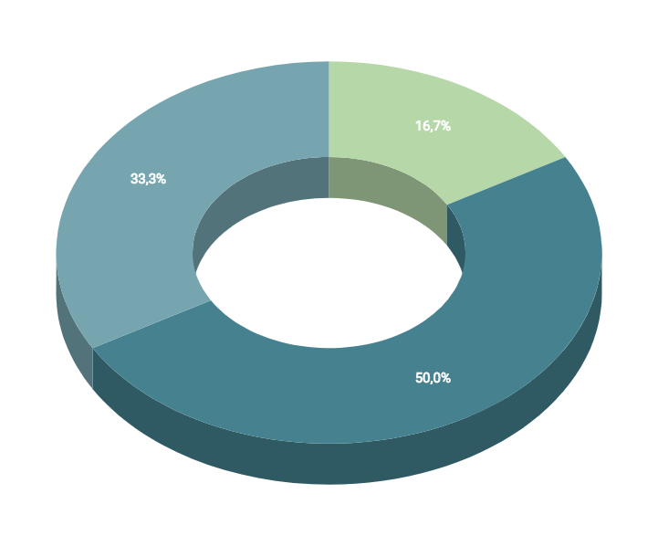
You can insert graphs from Google Sheets

Slide 48
ANDROID PROJECT
Show and explain your web, app or software projects using these gadget templates.
Place your screenshot here

Slide 49
iPHONE PROJECT
Show and explain your web, app or software projects using these gadget templates.
Place your screenshot here

Slide 50
TABLET PROJECT
Show and explain your web, app or software projects using these gadget templates.
Place your screenshot here

Slide 51
DESKTOP PROJECT
Show and explain your web, app or software projects using these gadget templates.
Place your screenshot here

Slide 52
THANKS!
Any questions?
You can find me at:
@username
user@mail.me

Slide 53
CREDITS
Special thanks to all the people who made and released these awesome resources for free:
Presentation template by SlidesCarnival
Photographs by Unsplash

Slide 54
PRESENTATION DESIGN
This presentation uses the following typographies and colors:
Titles: Dosis
Body copy: Titillium Web
You can download the fonts on these pages:
http://www.impallari.com/dosis
http://www.campivisivi.net/titillium/
Pastel green #d3ebd5 · Green #80bfb7 · Teal #0b87a1 · Navy #01597f · Dark navy #003b55
You don’t need to keep this slide in your presentation. It’s only here to serve you as a design guide if you need to create new slides or download the fonts to edit the presentation in PowerPoint®

Slide 55
SlidesCarnival icons are editable shapes.
This means that you can:
Resize them without losing quality.
Change fill color and opacity.
Change line color, width and style.
Isn’t that nice? :)
Examples:

Slide 56
Diagrams and infographics

Slide 57
😉
Now you can use any emoji as an icon!
And of course it resizes without losing quality and you can change the color.
How? Follow Google instructions https://twitter.com/googledocs/status/730087240156643328
✋👆👉👍👤👦👧👨👩👪💃🏃💑❤😂😉😋😒😭👶😸🐟🍒🍔💣📌📖🔨🎃🎈🎨🏈🏰🌏🔌🔑 and many more...

Slide 58

Free templates for all your presentation needs
For PowerPoint and Google Slides
100% free for personal or commercial use
Ready to use, professional and customizable
Blow your audience away with attractive visuals

